Slide 1
Categorical Feature Encoding Challenge
Binary classification, with every feature a categorical
evaluated on area under the ROC curve
Notes:
I will talk about a data analytics project from Kaggle. This is a playground competition. In this task, we will predict a probability for the target variable. Submissions are evaluated on area under the ROC curve between the predicted probability and the observed target.

Slide 2
Main Content
01
Background
02
EDA
03
Modeling
04
Conclusions
Intro project and data
Dataset overview
LightGBM / LR
One-hot/target encoding
Summary & compare
Notes:
My presentation will be in 4 parts. 1st I’m talking about the background about this competition and data. Then I’m going to share my data exploratory analysis.
Next step it is applying machine learning model and using the encoding strategies. Last, there will be a summary about the what I got from this competition.

Slide 3
01
Background
Kaggle hold playground competition. Deal with categorical variables.
Notes:
Kaggle is the company hosting this competition. If you win the competition, the prize is Kaggle Swag, which is the stuff gifted from Kaggle like tshirt, water bottle, pens. Thru this challenge, everyone has the opportunity to try different encoding schemes for different algorithms to compare how they perform.

Slide 4
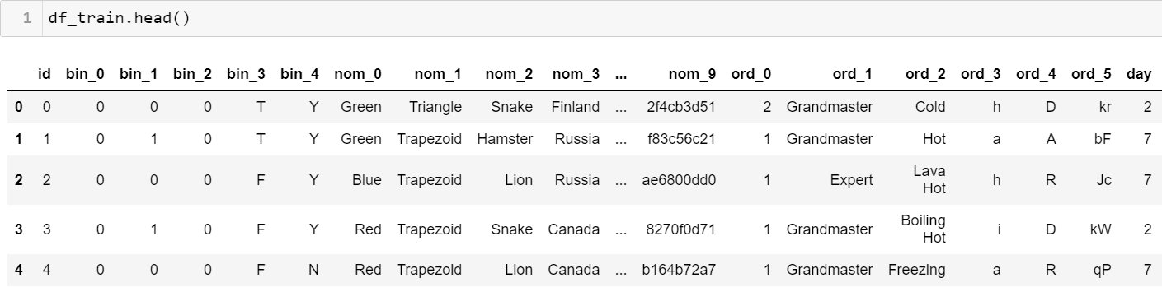
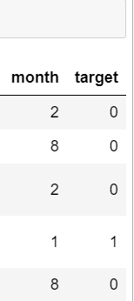
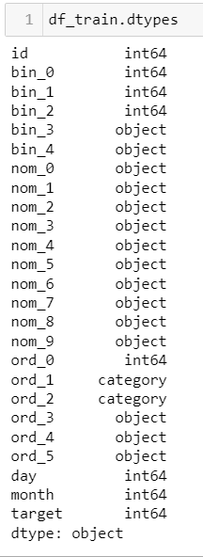
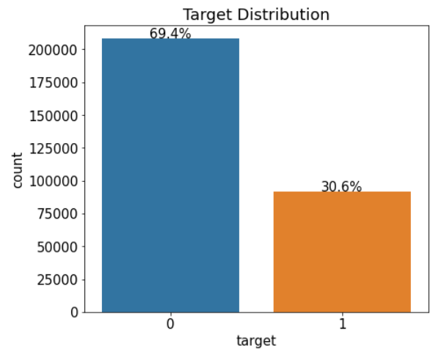


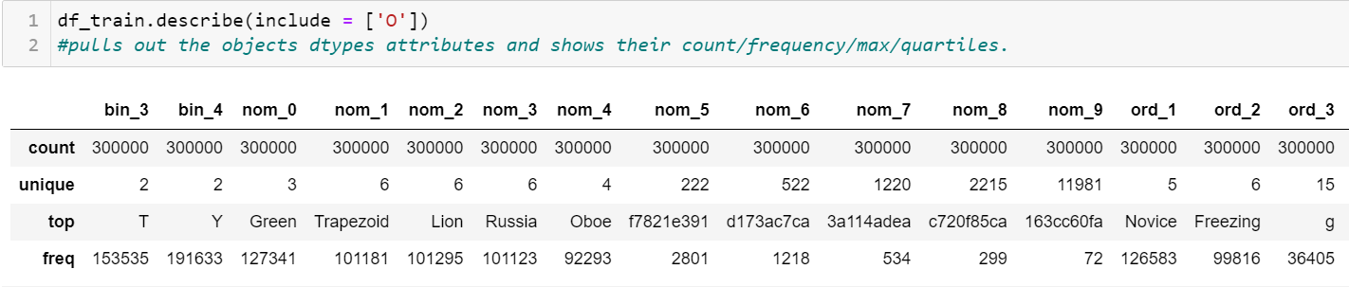
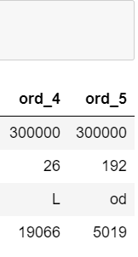
Train Data
Using a for loop for looking up what are the unique value in each column:
bin_0 value: [0 1]
bin_1 value: [0 1]
bin_2 value: [0 1]
bin_3 value: ['T' 'F']
bin_4 value: ['Y' 'N‘]
nom_0 value: ['Green' 'Blue' 'Red']
nom_1 value: ['Triangle' 'Trapezoid' 'Polygon' 'Square' 'Star' 'Circle']
nom_2 value: ['Snake' 'Hamster' 'Lion' 'Cat' 'Dog' 'Axolotl']
nom_3 value: ['Finland' 'Russia' 'Canada' 'Costa Rica' 'China' 'India']
nom_4 value: ['Bassoon' 'Piano' 'Theremin' 'Oboe‘]
nom_5 – 9: ['50f116bcf' 'b3b4d25d0‘ ... ]
ord_0 value: [1 2 3]
ord_1 value: ['Novice' 'Contributor' 'Expert' 'Master‘ 'Grandmaster']
ord_2 value: ['Freezing‘ 'Cold' 'Warm‘ 'Hot' 'Boiling Hot‘ 'Lava Hot']
ord_3 value: [‘a’ ‘b’ ‘c’ … ]
ord_4 value: [‘A' ‘B' ‘C’ … ]
ord_5 value: ['kr' 'bF' 'Jc’ ... ]
Notes:
Then let’s look at the data. In the train data therea are 300 thousand rows. 25 columns. In test data, same number of columns and 200 thousand rows.
This is the picture of the head of train data. Datatype. Isnull. No missing value. Then using describe to pull out ….. Count is 300 000. unique entry for each column is this row. Top count entry and its frequency of each column. By using a for loop, to looking thru what are the unique entries for each column. Then I got bin nom. Ord.
Id. Automatic system generated. 23 categorical columns.
bin 0-4：binary features (e.g.: 0/1, true/false, y/n)
Nom descriptive : low- 0-4 and high-5-9 cardinality nominal features (e.g.: color, shape, animal, instrument, country...)
ord with a natural order : low- 0-4 and high-5 cardinality ordinal features (e.g.: skill level rank, heat temperature level...)
day month : cyclical features
target: 0/1 target distribution are balanced at 70% of 0 -30% of 1.

Slide 5
02
Data Exploratory
Understand provided dataset
Notes:
In this step, I’m going to understand dataset better using graph or by looking at the target ratio. Is it able to find a pattern especially for the ordinal features between the target? Trying to find something new that are not directly showed from the data frame on the previous slides.

Slide 6
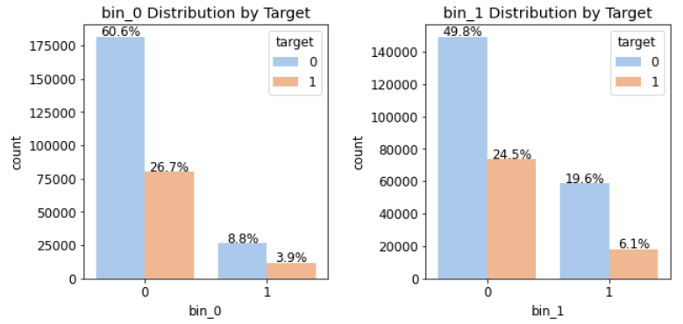
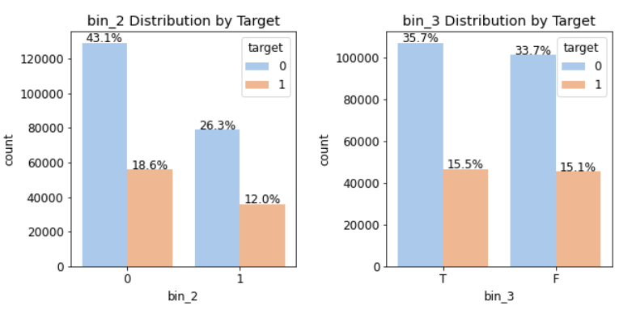
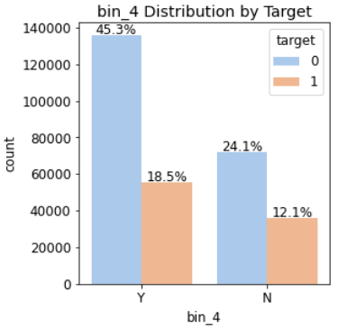
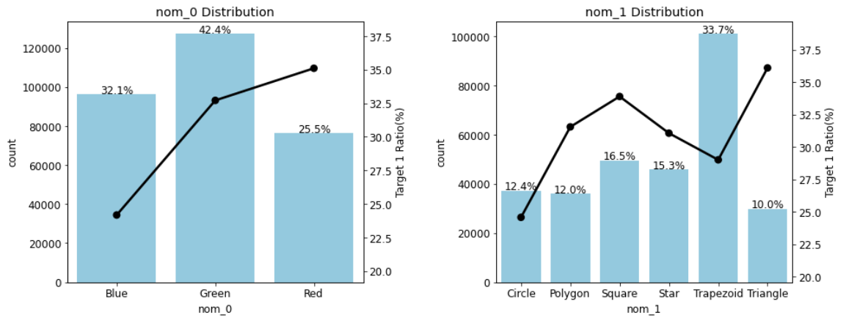
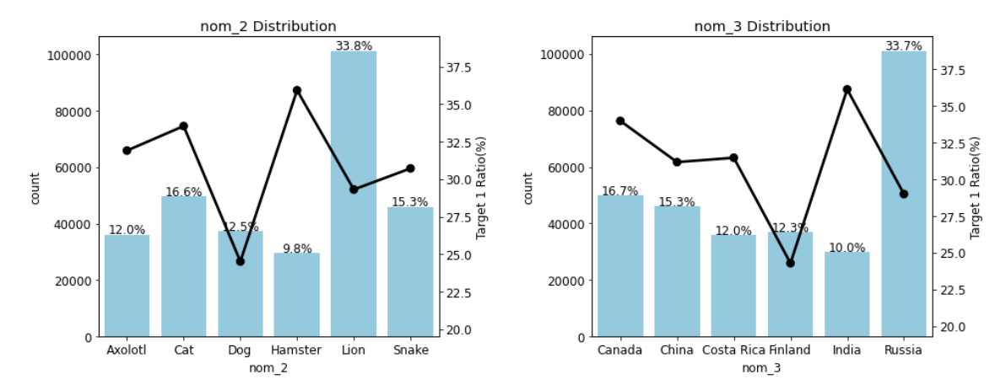
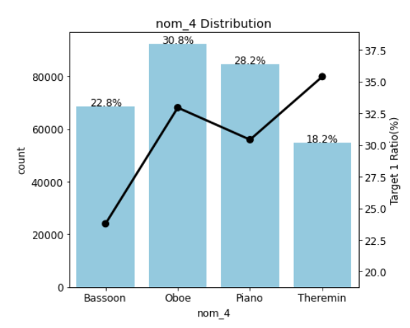
Feature Distributions
Notes:
Plot some histogram. By doing this, it’s easily to look at what’s the distribution of each column. Example, for bin_0, there are 0 and 1. In bin_3, T or F are very close with T. Here are the nominal features distribution. Black line is the target Ratio for each value; NOM_0 - Red (~35%) value highest ; NOM_1 - Triangle(~36%); NOM_2 - Hamster(~36%); NOM_3 - India(~36%) ; NOM_4 - Theremin(~36%). What we can see is with lowest frequency on the nominal category’s. there are highest % of target 1 ratio; nom_5 to 9 not listed have a huge cardinality.

Slide 7
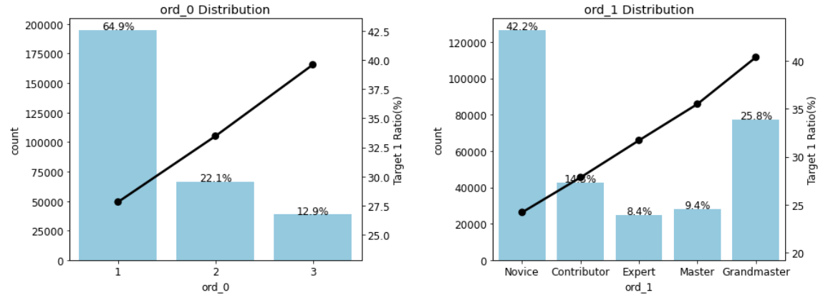
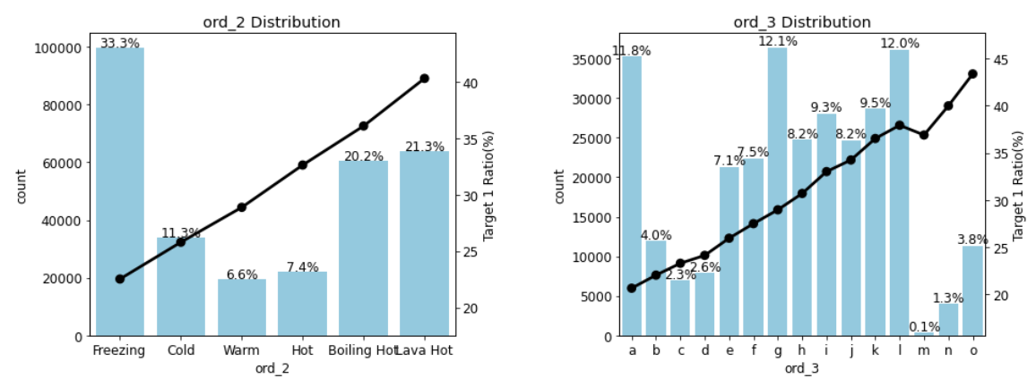
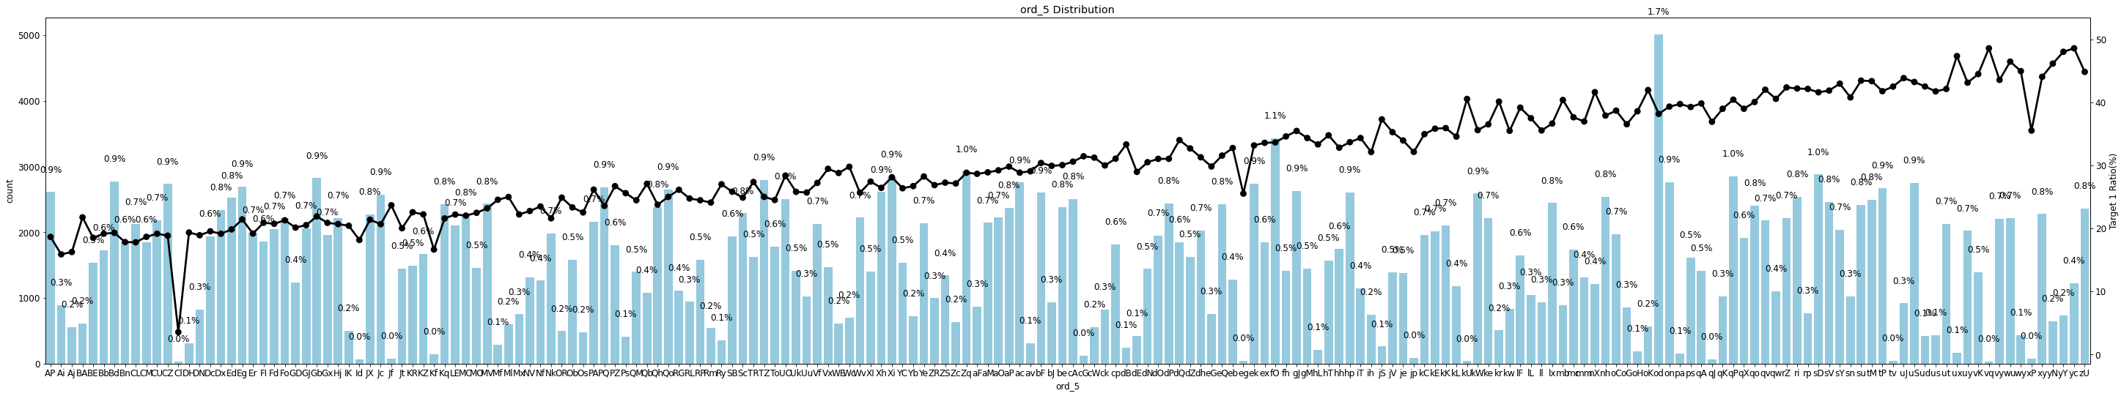
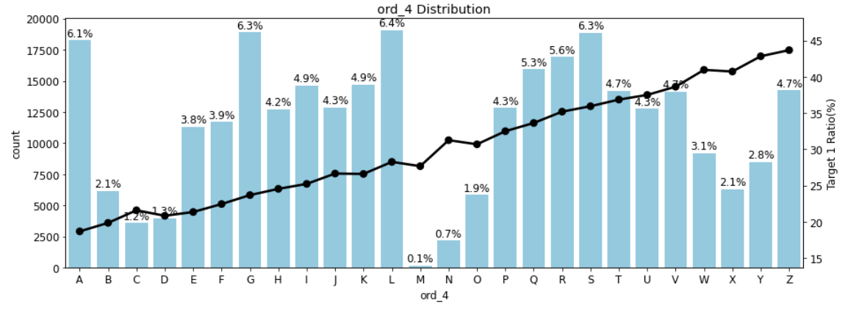
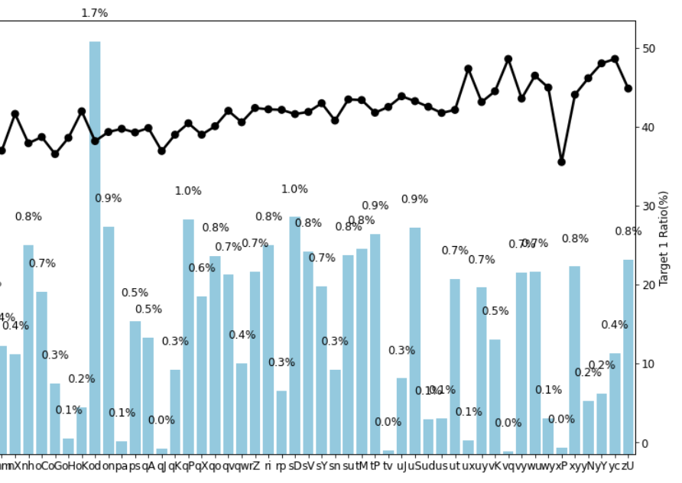
Feature Distributions
Entry of ‘od’ has the highest frequency.
Notes:
Ordinal distribution listed we can see a upward line of target 1 ratio for each column, which means there’s positive relation when you have a higher rank value, the more probability is for target 1. ord_5 has quite a lot of unique values; a high cardinality. Enlarge picture of ord_5, Entry of ‘od’ has the highest frequency.

Slide 8
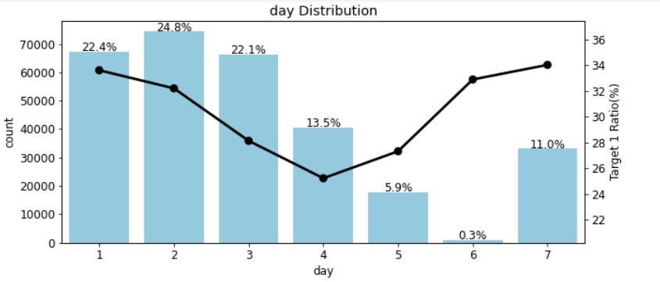
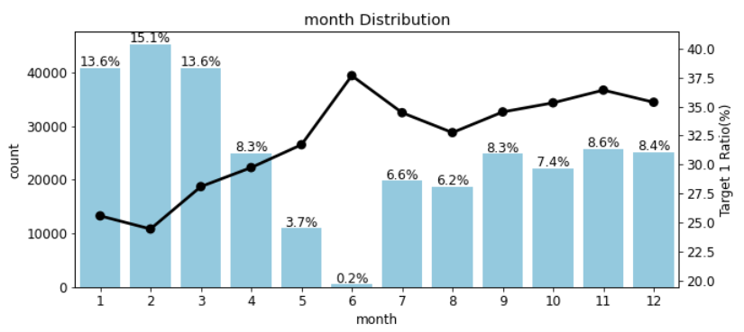
Feature Distributions
Notes:
Day 6 and month 6 with lowest frequency recorded in dataset.

Slide 9
03
Modeling
LightGBM / LR
Notes:
Now we try to chose machine learning algorithms and by using the Roc curve to evaluate which one is better.

Slide 10
LightGBM
Logistic Regression
LightGBM is a histogram-based algorithm that performs bucketing of values
Designed for large and complicated datasets
Uses decision trees for ranking, classification, and regression tasks
Focuses on computation speed and model high-performance
LR is a statistical analysis method to predict the binary outcome
predicts a dependent variable by analyzing the relationship between one or more independent variables.
It’s a supervised classification algorithm
Split the training dataset into train 80% and validation 20%.
gridsearch
Notes:
LightGBM making it useful for handling large datasets with high-dimensional features. It is designed to be efficient and scalable.
binary classification problems where the goal is to predict a binary outcome, such as yes/no or true/false. It is a simple and efficient algorithm that can handle a large number of features and is easy to interpret.

Slide 11
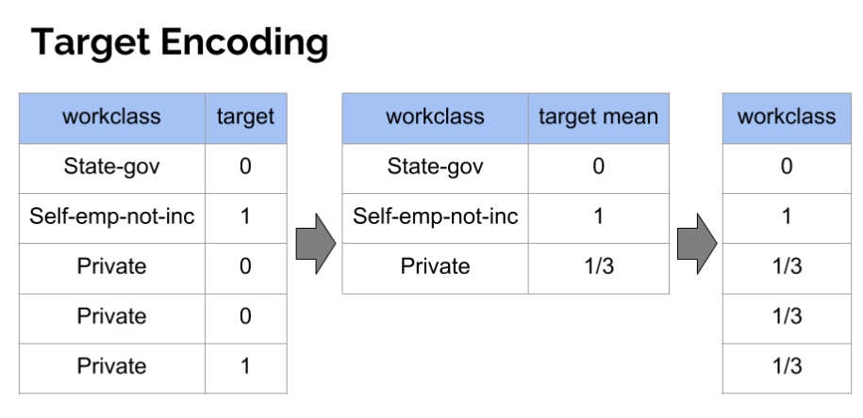
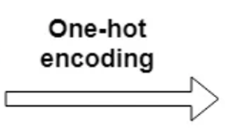
One Hot Encoding
Target Encoding
OHE is a representation method that takes each category value and turns it into a binary vector of size |i|(number of values in category i) where all columns are equal to zero besides the category column.
The advantage of this methos is that is uses very less memory/cpu resourses.
300000 rows and 16461 columns
Target-based encoding is numerization of categorical variables via target
The main drawbacks of this method are its dependency to the distribution of the target, and its lower predictability power compare to the binary encoding method
nom_3
Green
Blue
red
d1 | d2 | d3
1 | 0 | 0
0 | 1 | 0
0 | 0 | 1
Notes:
Machine learning models can only work with numerical values. For this reason, it is necessary to transform the categorical values of the relevant features into numerical numbers. In general, one-hot encoding is preferred when the number of categories is small and the categories are equally important, while target encoding is preferred when there are many categories or few observations per category, or when the categories have significantly different target variable values. Looking at an example. Prviate. Target encoding involves replacing each category of a catergorical variable with the mean of the target variable for the category.

Slide 12
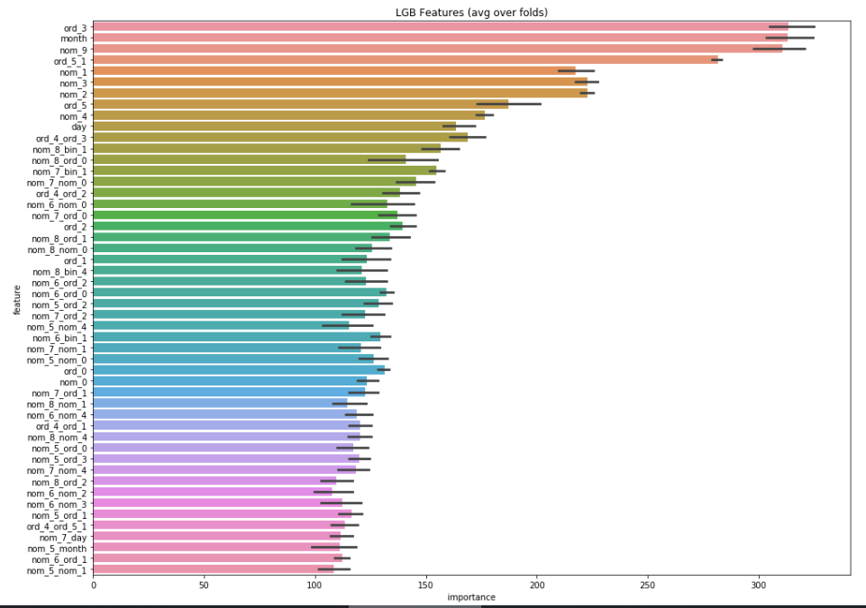
04
Conclusion
LightGBM performs better
One hot encoding fits better
nom_5 – 9 could be a kind of encrypt value
Feature importance top 3: ord_3, month, nom_9
roc_auc_score | LightGBM | LR
One hot encoding | 0.787 | 0.759
Target Encoding | 0.786 | 0.694

Slide 13
Comparison with Top
One-Hot Encode all; then thermometer encode some ordinal columns – one of the most voted Gold solution using Logistic Regression auc 0.808.
Using OrdinalEncoder, Feature hashing (a.k.a the hashing trick)
Encoding cyclical data is to transform the data into two dimensions using a sine and consine transformation.
Kfold/StratifiedKFold on LR
Normalization
Notes:
The submission work on Kaggle is disabled. But if made with the private score, may have a rank of 788.

